Slide 1

CSE- 321
Software Engineering
Lecture : 10-11 Software design
Fahad Ahmed
Lecturer, Dept. of CSE
E-mail: fahadahmed@uap-bd.edu

Slide 2
Lecture Outlines
Software design
Design Principles
Strategy of Design
Coupling and Cohesion
Architectural Design
Abstract machine (layered) Design
Distributed Systems Architectures
Client-Server Architecture
Broker Architectural Style : CORBA
Service-Oriented Architecture (SOA)

Slide 3
Software design
What is Software design ?
Software design is a process to transform user requirements into some suitable form, which helps the programmer in software coding and implementation.
Software design is the first step in SDLC (Software Design Life Cycle), which moves the concentration from problem domain to solution domain. It tries to specify how to fulfill the requirements mentioned in SRS.

Slide 4
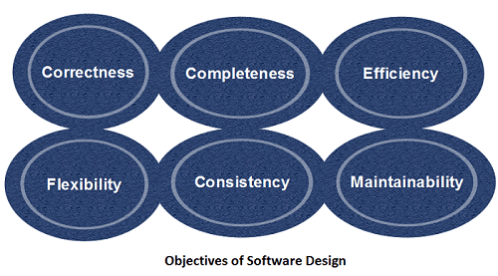
Objectives of Software Design

Slide 5
Objectives of Software Design
Objectives of Software Design
Following are the purposes of Software design:
Correctness: Software design should be correct as per requirement.
Completeness: The design should have all components like data structures, modules, and external interfaces, etc.
Efficiency: Resources should be used efficiently by the program.
Flexibility: Able to modify on changing needs.
Consistency: There should not be any inconsistency in the design.
Maintainability: The design should be so simple so that it can be easily maintainable by other designers.

Slide 6
Software Design Levels
Software design yields three levels of results:
Architectural Design
Highest abstract version of the system.
It identifies the software as a system with many components interacting with each other.
Designers get the idea of proposed solution domain.
High-level Design
Breaks the ‘single entity-multiple component’ concept of architectural design into less-abstracted view of sub-systems and modules and depicts their interaction with each other.
Detailed Design
Detailed design deals with the implementation part of what is seen as a system and its sub-systems in the previous two designs

Slide 7
Software Design Principles
Design is not coding, coding is not design.
The design should be traceable to the analysis model.
The design should not reinvent the wheel.
The design should “minimize the intellectual distance” between the software and the problem as it exists in the real world.
The design should exhibit uniformity and integration.
The design should be structured to accommodate change.
The design should be structured to degrade gently, even when aberrant data, events, or operating conditions are encountered.
The design should be assessed for quality as it is being created, not after the fact.
The design should be reviewed to minimize conceptual (semantic) errors.

Slide 8
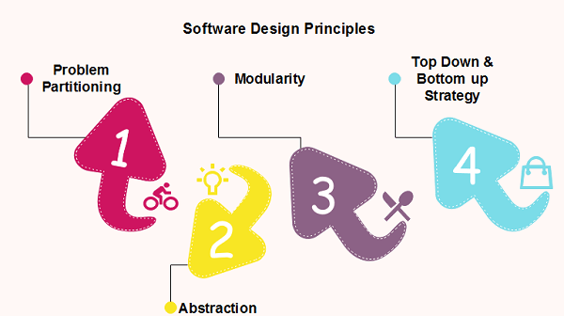
Software Design Principles
Software design principles are concerned with providing means to handle the complexity of the design process effectively.

Slide 9
Software Design Principles
Problem Partitioning
For small problem, we can handle the entire problem at once
but for the significant problem, divide the problems and conquer the problem it means to divide the problem into smaller pieces so that each piece can be captured separately.
Benefits of Problem Partitioning
Software is easy to understand
Software becomes simple
Software is easy to test
Software is easy to modify
Software is easy to maintain
Software is easy to expand
As the number of partition increases = Cost of partition and complexity increases

Slide 10
Modularization
Modularization is a technique to divide a software system into multiple discrete and independent modules, which are expected to be capable of carrying out task(s) independently. These modules may work as basic constructs for the entire software.
Advantage of modularization:
Smaller components are easier to maintain
Program can be divided based on functional aspects
Desired level of abstraction can be brought in the program
Components with high cohesion can be re-used again
Concurrent execution can be made possible
Desired from security aspect

Slide 11
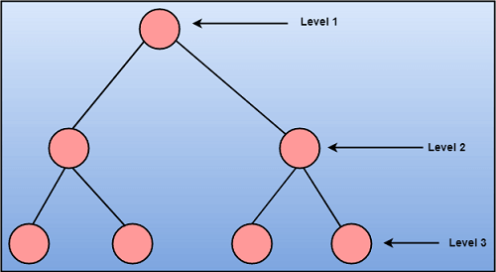
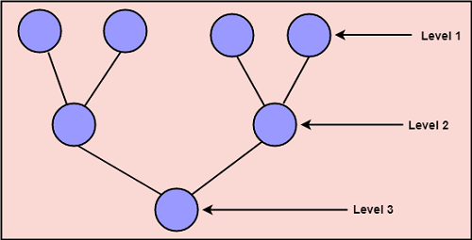
Strategy of Design
To design a system, there are two possible approaches:
Top-down Approach
Bottom-up Approach
Top-down Approach
Bottom-up Approach

Slide 12
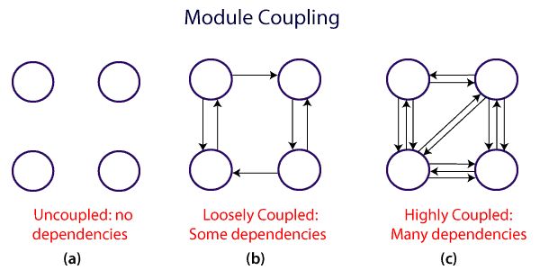
Coupling and Cohesion
Module Coupling
In software engineering, Coupling is measured by the number of relations between the modules. That means, the coupling is the degree of interdependence between software modules.
A good design is the one that has low coupling.

Slide 13
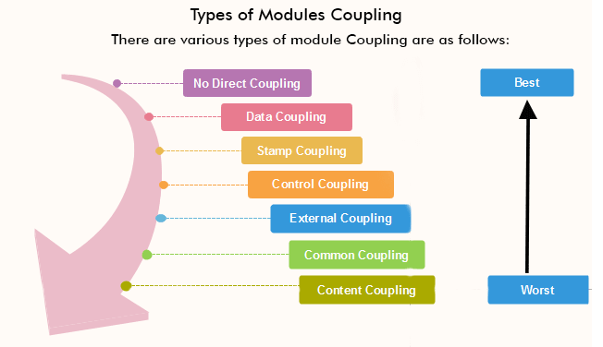
Coupling and Cohesion
Types of Module Coupling
https://www.javatpoint.com/software-engineering-coupling-and-cohesion

Slide 14
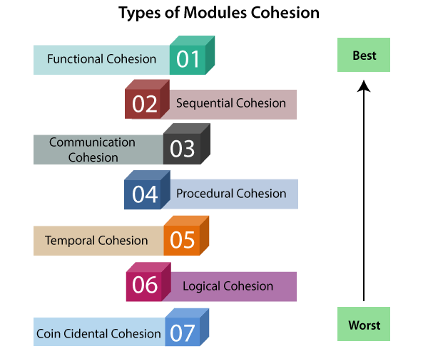
Coupling and Cohesion
Module Cohesion
cohesion defines to the degree to which the elements of a module belong together. Thus, cohesion measures the strength of relationships between pieces of functionality within a given module.
Basically, cohesion is the internal glue that keeps the module together.
A good software design will have high cohesion.
https://www.javatpoint.com/software-engineering-coupling-and-cohesion

Slide 15
Coupling vs Cohesion
Coupling | Cohesion
Coupling is also called Inter-Module Binding. | Cohesion is also called Intra-Module Binding.
Coupling shows the relationships between modules. | Cohesion shows the relationship within the module.
Coupling shows the relative independence between the modules. | Cohesion shows the module's relative functional strength.
While creating, you should aim for low coupling, i.e., dependency among modules should be less. | While creating you should aim for high cohesion, i.e., a cohesive component/ module focuses on a single function (i.e., single-mindedness) with little interaction with other modules of the system.
In coupling, modules are linked to the other modules. | In cohesion, the module focuses on a single thing.

Slide 16
Design Pattern
A design pattern provides a general reusable solution for the common problems occurs in software design.
The patterns typically show relationships and interactions between classes or objects.
The idea is to speed up the development process by providing well tested, proven development/design paradigm. Design patterns are programming language independent strategies for solving a common problem.
That means a design pattern represents an idea, not a particular implementation. By using the design patterns you can make your code more flexible, reusable and maintainable.

Slide 17
Design Pattern
Types of Design Patterns There are mainly three types of design patterns:
1.Creational Design Pattern
Factory Pattern
Abstract Factory Pattern
Singleton Pattern
Prototype Pattern
Builder Pattern.
3. Behavioural Design Pattern
Chain Of Responsibility Pattern
Command Pattern
Interpreter Pattern
Iterator Pattern
Mediator Pattern
Memento Pattern
Observer Pattern
State Pattern
Strategy Pattern
Template Pattern
Visitor Pattern
2. Structural Design Pattern
Adapter Pattern
Bridge Pattern
Composite Pattern
Decorator Pattern
Facade Pattern
Flyweight Pattern
Proxy Pattern

Slide 18
Design Pattern
Difference Between Architectural Style, Architectural Patterns
Architectural Style
The architectural style shows how do we organize our code, or how the system will look like from 10000 feet helicopter view to show the highest level of abstraction of our system design. Furthermore, when building the architectural style of our system we focus on layers and modules and how they are communicating with each other.
Architectural Patterns
The architectural pattern shows how a solution can be used to solve a reoccurring problem. In another word, it reflects how a code or components interact with each other

Slide 19
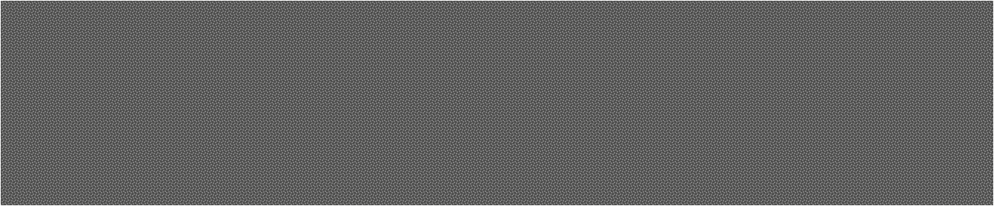

Architectural Design

Slide 20
Architectural Design
Architectural design is a process for identifying the sub-systems making up a system and the framework for sub-system control and communication.
The output of this design process is a description of the software architecture.
It represents the link between specification and design processes
Often carried out in parallel with some specification activities.
It involves identifying major system components and their communications.

Slide 21
Architectural Design
A software architecture is a description of how a software system is organized.
Architectural design decisions include decisions on the type of application, the distribution of the system, the architectural styles to be used.
Architectures may be documented from several different perspectives or views such as a conceptual view, a logical view, a process view, and a development view.
Architectural patterns are a means of reusing knowledge about generic system architectures.
Architectural patterns are similar to software design pattern but have a broader scope.

Slide 22
Architectural design decisions
Architectural design is a creative process so the process differs depending on the type of system being developed.
However, a number of common decisions span all design processes.
Is there a generic application architecture that can be used?
How will the system be distributed?
What architectural styles are appropriate?
What approach will be used to structure the system?
How will the system be decomposed into modules?
What control strategy should be used?
How will the architectural design be evaluated?
How should the architecture be documented?

Slide 23
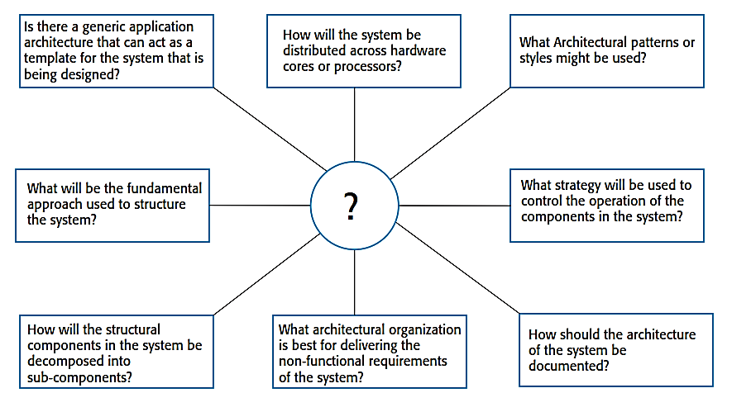
Architectural design decisions

Slide 24
Architectural views
4 + 1 view model of software architecture
· A logical view, which shows the key abstractions in the system as objects or object classes.
· A process view, which shows how, at run-time, the system is composed of interacting processes.
· A development view, which shows how the software is decomposed for development.
· A physical view, which shows the system hardware and how software components are distributed across the processors in the system.
· Related using use cases or scenarios (+1)

Slide 25
Architectural patterns
Patterns are a means of representing, sharing and reusing knowledge.
An architectural pattern is a stylized description of good design practice, which has been tried and tested in different environments.
Patterns should include information about when they are and when they are not useful.
Patterns may be represented using tabular and graphical descriptions.

Slide 26
The Model-View-Controller (MVC) pattern
MVC (Model-View-Controller) is a pattern in software design commonly used to implement user interfaces, data, and controlling logic.
It emphasizes a separation between the software’s business logic and display.
This "separation of concerns" provides for a better division of labour and improved maintenance.
Some other design patterns are based on MVC, such as
MVVM (Model-View-Viewmodel),
MVP (Model-View-Presenter), and
MVW (Model-View-Whatever).

Slide 27
The Model-View-Controller (MVC) pattern
Serves as a basis of interaction management in many web-based systems.
Decouples three major interconnected components:
The model is the central component of the pattern that directly manages the data, logic and rules of the application. It is the application's dynamic data structure, independent of the user interface.
A view can be any output representation of information, such as a chart or a diagram. Multiple views of the same information are possible.
The controller accepts input and converts it to commands for the model or view.
Supported by most language frameworks.

Slide 28
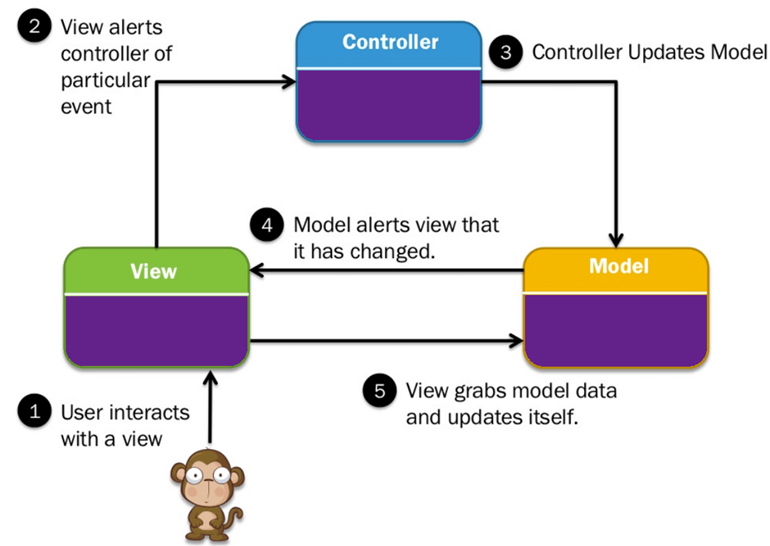
The Model-View-Controller (MVC) pattern
MVC architectural pattern

Slide 29
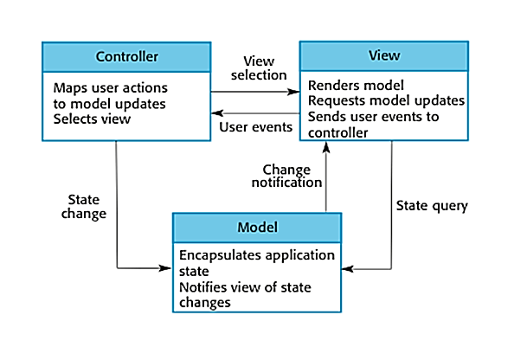
The Model-View-Controller (MVC) pattern
MVC architectural pattern

Slide 30
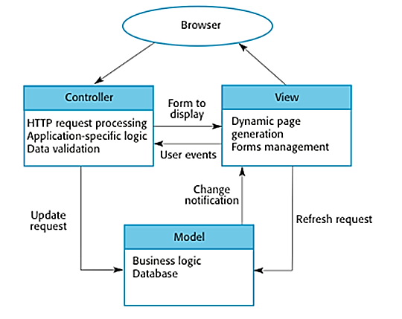
The Model-View-Controller (MVC) pattern
Web application architecture using the MVC pattern

Slide 31
The Model-View-Controller (MVC) pattern
Case- Study : restaurant
Let's assume you go to a restaurant. You will not go to the kitchen and prepare food which you can surely do at your home. Instead, you just go there and wait for the waiter to come on.
Now the waiter comes to you, and you just order the food. The waiter doesn't know who you are and what you want he just written down the detail of your food order.
Then, the waiter moves to the kitchen. In the kitchen waiter not prepare your food.
The cook prepares your food. The waiter is given your order to him along with your table number.
Cook then prepared food for you. He uses ingredients to cooks the food. Let's assume that your order a vegetable sandwich. Then he needs bread, tomato, potato, capsicum, onion, bit, cheese, etc. which he sources from the refrigerator
Cook final hand over the food to the waiter. Now it is the job of the waiter to moves this food outside the kitchen.
Now waiter knows which food you have ordered and how they are served.

Slide 32
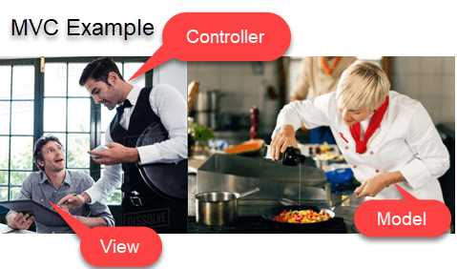
The Model-View-Controller (MVC) pattern
Case- Study : restaurant
In this case,
You= View
Waiter= Controller
Cook= Model
Refrigerator= Data

Slide 33
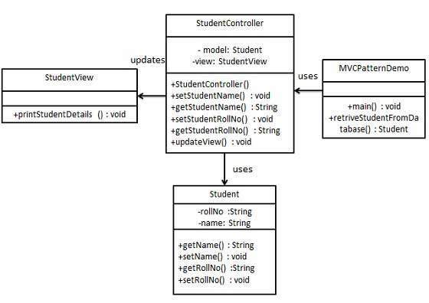
Coding Style : MVC
https://www.tutorialspoint.com/design_pattern/mvc_pattern.htm

Slide 34
Design Patterns - MVC
Step 1
Create Model
public class Student {
private String rollNo;
private String name;
public String getRollNo() {
return rollNo;
}
public void setRollNo(String rollNo) {
this.rollNo = rollNo;
}
public String getName() {
return name;
}
public void setName(String name) {
this.name = name;
}
}

Slide 35
Design Patterns - MVC
Step 2
Create view
public class StudentView {
public void printStudentDetails(String studentName, String studentRollNo){
System.out.println("Student: ");
System.out.println("Name: " + studentName);
System.out.println("Roll No: " + studentRollNo);
}
}

Slide 36
Design Patterns - MVC
public class StudentController {
private Student model;
private StudentView view;
public StudentController(Student model, StudentView view){
this.model = model;
this.view = view;
}
public void setStudentName(String name){
model.setName(name);
}
public String getStudentName(){
return model.getName();
}
public void setStudentRollNo(String rollNo){
model.setRollNo(rollNo);
}
public String getStudentRollNo(){
return model.getRollNo();
}
public void updateView(){
view.printStudentDetails(model.getName(), model.getRollNo());
}
}
Step 3
Create Controller

Slide 37
Design Patterns - MVC
Step 4
MVCPatternDemo
public class MVCPatternDemo {
public static void main(String[] args) {
//fetch student record based on his roll no from the database
Student model = retriveStudentFromDatabase();
//Create a view : to write student details on console
StudentView view = new StudentView();
StudentController controller = new StudentController(model, view);
controller.updateView();
//update model data
controller.setStudentName("John");
controller.updateView();
}
private static Student retriveStudentFromDatabase(){
Student student = new Student();
student.setName("Robert");
student.setRollNo("10");
return student;
}
}
In Python https://www.tutorialspoint.com/python_design_patterns/python_design_patterns_model_view_controller.htm

Slide 38
Design Patterns - MVC
Step 5
Verify the output.
Student:
Name: Robert
Roll No: 10

Slide 39
MVVM
What is MVVM?
MVVM architecture facilitates a separation of development of the graphical user interface with the help of mark-up language or GUI code.
The full form of MVVM is Model–View–ViewModel.
MVVM removes the tight coupling between each component.
Most importantly, in this architecture, the children don't have the direct reference to the parent, they only have the reference by observables.

Slide 40
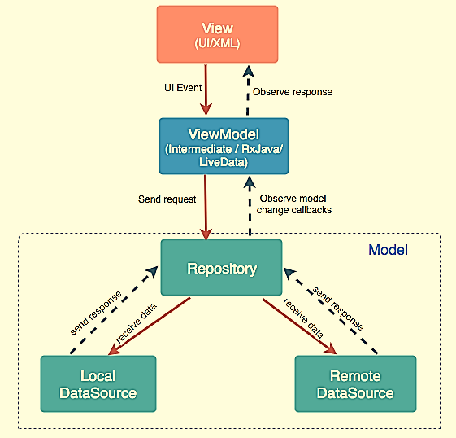
MVVM

Slide 41
MVVM
Model: It represents the data and the business logic of the Application. It consists of the business logic - local and remote data source, model classes, repository.
View: It consists of the UI Code (Activity, Fragment), XML. It sends the user action to the ViewModel but does not get the response back directly. To get the response, it has to subscribe to the observables which ViewModel exposes to it.
ViewModel: It is a bridge between the View and Model(business logic). It does not have any clue which View has to use it as it does not have a direct reference to the View. So basically, the ViewModel should not be aware of the view who is interacting with. It interacts with the Model and exposes the observable that can be observed by the View.

Slide 42

Thanks to All

